Slide 1
Year 6 Information Evening
Monday 19th October 2026

Slide 2

Year 6 Parent Information
Expectations of Year 6
Key Dates & Communication
Year 6 Residential Trip
SATs

Slide 3


Year 6 Organisation & Routines
8:25 AM
8:30 - 9:00 AM
MONDAY → MONDAY
School Day Begins
School day begins at 8:25 — children straight into open classrooms.
Morning Sessions
Half an hour morning sessions, incl. targeted support.
★ 2.5 hours total through the week
Homework
As we progress through the year, this is more targeted.
Good, regular routine at home = your child feeling confident, relaxed and on top of their learning.

Slide 4

Attendance & Punctuality
★ National: Children are more likely to be coming to school every day. 5.31% in 25/26 down from 6.7% absence in 23/24.
★ 84% of Year 6 pupils who had 100% attendance achieved the expected standard, compared to 40% of pupils with 90% attendance
★ If a child is late and misses learning, they will complete this at a break/lunchtime or after school

Slide 5
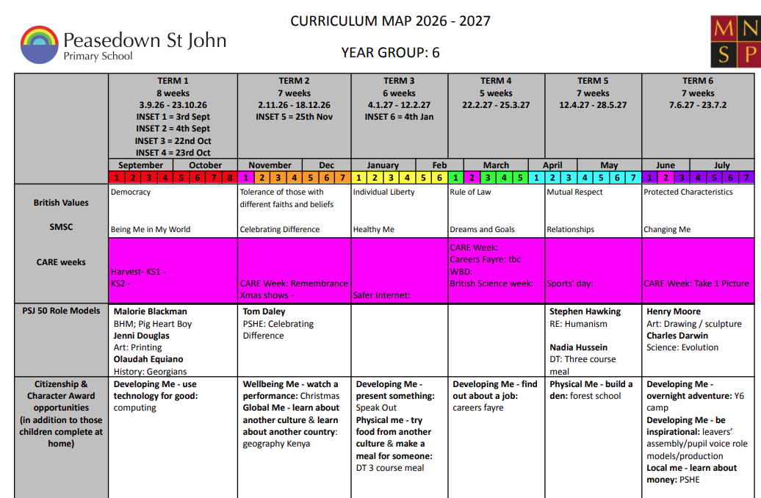
★ Broad and balanced - all subjects
★ Units are linked to each other where possible:
Attendance is key!
Year 6 Curriculum

Slide 6
Behaviour Expectations
Role Models
Demonstrating CARE values daily, consistently
Resilience & Aspiration
Making their mark and leaving a positive legacy. Bouncing back and trying again.
Responsibility & Self-Regulation
Strategies through PSHE lessons, circle times and whole-class movement/calm breaks.
Behaviour Policy
Disrupting or preventing other children from learning is unacceptable and dealt with according to the behaviour policy.

Slide 7
Online Safety & Mobile Phones
Smartphone Use
Does your child need a smartphone to walk the distance from your door to school?
WhatsApp & Group Chats
• WhatsApp legal age restriction: 13+
• Group chat settings - review these regularly
• Explicit, inappropriate or unkind images/messages are a huge issue - check your child’s phone
Communication & Boundaries
• Talk to your child regularly - have a phone contract
• Teaching time is wasted if we are sorting out upsets caused online
Helpful Resources
Bank of helpful resources to keep your child safe:
E-Safety - Peasedown St John Primary School

Slide 8
Homework Overview
Homework Club
Tuesdays
Homework | Day out | Day due back
Reading (Reading Record and CGP Books) | Every day | 5 x reads by Friday
Maths (Times Tables Rockstars - TTRS) | Monday | Monday
Spelling (Spelling practice on Spelling Frame) | Monday | Monday
Maths (Doodle Maths / CGP Books) | Monday (As needed) | Monday

Slide 9
Reading Records
★ Daily home reading expectation. Mixture of independent and with an adult - knowing your child
★ Reading record signed as part of homework expectation
★ ‘ZPD’: reading level from tests in school with books closely matched. www.arbookfind.co.uk

Slide 10





Year 6 Class Novels
Support by: Asking about events; favourite characters. What happened today? Did you learn any new word meanings? Practise using those words in everyday conversation.

Slide 11


Year 6 Maths
★ A level up; building on Year 3, 4 and 5 knowledge and an opportunity to show off their knowledge and skills during SATs week
★ Challenging, exciting and fun!
★ Positive, resilient attitude to challenges
Support by: Counting whilst out and about, cooking and measuring, giving pocket money to budget, telling the time, using bus/train timetables, online resources and games.

Slide 12
Ideas to support the curriculum
Inheritance & Evolution
Discuss inherited characteristics within the family
Visit the Radstock Museum
The Heart & Blood
Books: Kay’s Anatomy, Anatomicum
Encourage children to notice their heart rate during exercise
Georgian Bath & Bristol
Go on a walk and spot Georgian buildings and historical locations
Visit the Georgian Museum (again!)
Geography
Spend time looking at maps/globes/Google Maps and identifying different places
Three-Course Meal
Involve your child with cooking and food shopping
Visit We The Curious in Bristol
PSHE (Jigsaw)
Encourage your child to recognise their emotions and practise self-regulation
Discuss ways to overcome worries

Slide 13
Key Days & Dates
Term 1: SEND parents meetings, trip to Parliament, 3 course meal
Term 2: Trip to Bath, Parents Progress Meeting, CARE Week, Anti-bullying Week Christmas
Term 3: Internet Safety, Speak Out , 3 course meal
Term 4: Careers Fayre, CARE Week, British Science Week
Term 5: SATs, Forest School, Sports Day
Term 6: Residential Trip, Forest School, catch up swimming, CARE Week, RSE lessons, Y6 Production, transition

Slide 14
Secondary School Transition
★ The year is planned to allow for opportunities to become ‘secondary ready’ - building resilience, new friendships and groupings, changes of rooms and Year 6 routines
★ French lessons with NH staff - secondary expectations
★ Later in the year: visits from secondary school pastoral staff; transition focus in PSHE; support groups where needed
Uniform expectations

Slide 15
Secondary School Application
★ The deadline to apply is 31st October

Slide 16
Communication
★ Newsletter
★ https://www.psjprimary.co.uk/our-classes/
★ Email or call office well ahead of time for appointments, changes to pick-up arrangements. Appointments count towards attendance as your child is missing out on learning - arrange routine appointments after school where possible.

Slide 17

Year 6 Residential:
Creating everlasting memories
Strengthen senses of independence and transition to secondary
Strengthen friendships
Challenge themselves
Have fun!

Slide 18
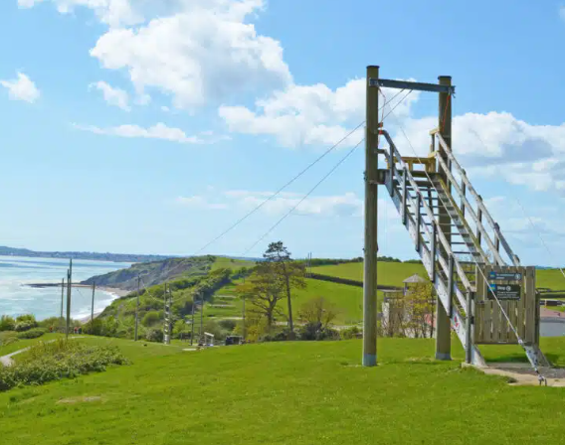

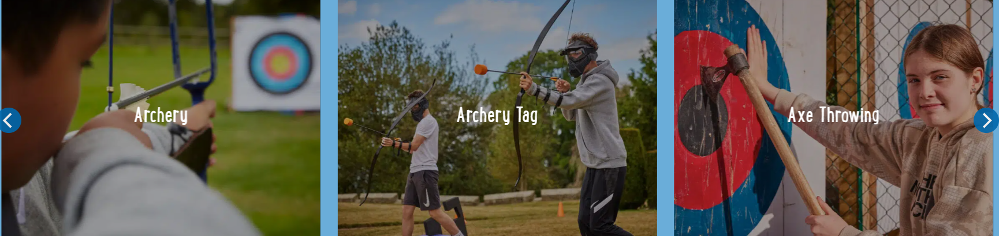
Year 6 Residential:
★ Aims of resilience and independence building are central through all activities
★ Morning meetings and evening reflection times - how has our teamwork strengthened today? How did we overcome challenges? Who has excelled?

Slide 19
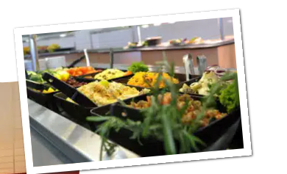
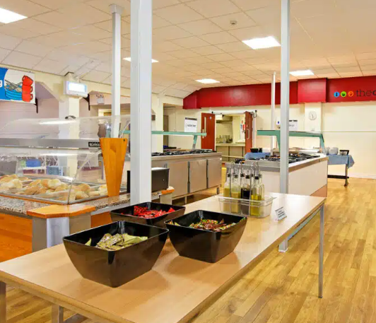
Meals
Healthy, balanced menu presented in a way that is familiar and appetising to children. There will be several options for each evening meal as well as a range available at breakfast and lunch times.
Specific dietary requirements and allergies will be catered for and must be notified in advance: medical/dietary forms.
Water bottles must be packed!

Slide 20

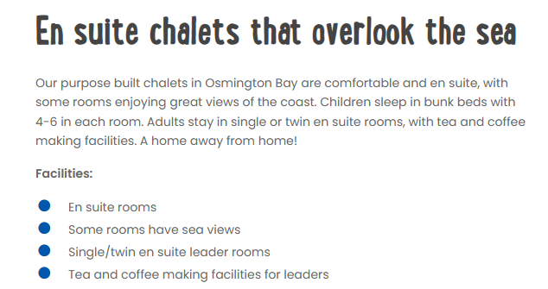
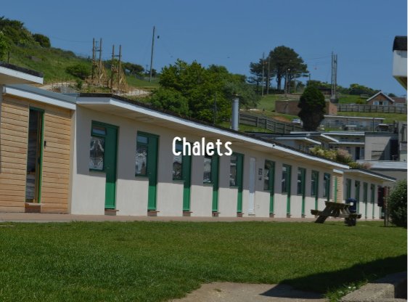
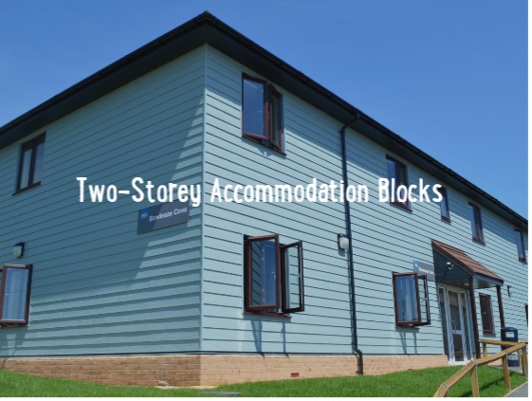
Rooms & Activity Groups
★ Room group - on arrival
★ Activity group - on arrival
★ Morning/evening in
★ Whole year group

Slide 21
Key to note
We will hold a meeting in April to ensure you have all the correct paperwork signed and your child is fully prepared for the trip.
Please maintain your payment installments.

Slide 22
SATs Week: Monday 10th May
Date | Test | Duration
Monday 10th May | Grammar, Punctuation & Spelling | 45 minutes
 | Spelling test | Approx. 20 minutes
Tuesday 11th May | Reading | One hour
Wednesday 12th May | Mathematics 1: Arithmetic | 30 minutes
 | Mathematics 2: Reasoning | 40 minutes
Thursday 13th May | Mathematics 2: Reasoning | 40 minutes
Friday - Focus turns to writing and celebration of Year 6 effort through the week!

Slide 23
Scores & Scaled Scores
Expected Standard
Raw Score
National target for Y6 pupils. Graded as:
WTS: Working Towards Standard
EXS: Expected Standard
GDS: Greater Depth Standard
The total number of marks achieved directly on the test paper.
Example: 39 / 50 marks
Scaled Score
Benchmark Goal
The raw score is converted into a scaled score using an official conversion table.
This ensures fair comparison across different test years.
A scaled score of 100 represents the expected standard.
Scores range from 80 to 120.

Slide 24
Scores & Scaled Scores
Paper 1: Arithmetic | Paper 2: Reasoning: | Paper 3: Reasoning | Raw score | Scaled score | Outcome
34 | 19 | 31 | 84 | 105 | AS
12 | 9 | 9 | 30 | 91 | NS
39 | 31 | 34 | 104 | 114 | AS
30 | 26 | 29 | 85 | 106 | AS
35 | 22 | 31 | 88 | 107 | AS
34 | 28 | 25 | 87 | 106 | AS

Slide 25
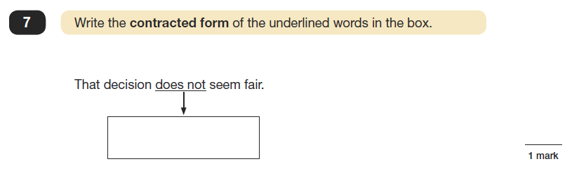
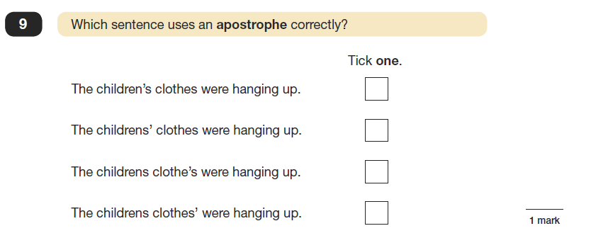

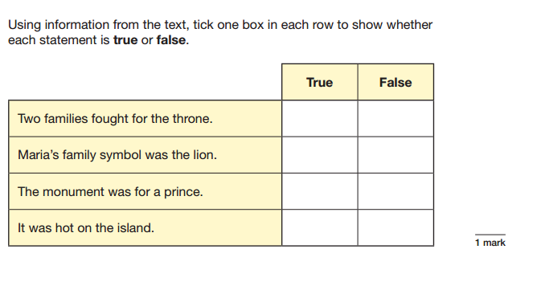
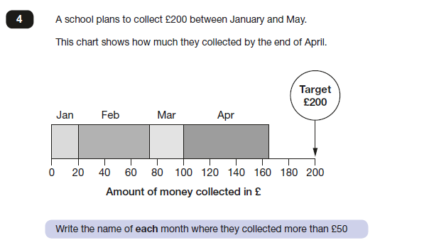

Slide 26
Aspirations & Myths
Year 6 SATs
← Sets, targeted support →
Reception
Y11 & GCSEs
★ A rite of passage and something every Y6 child experiences
★ Used by secondary schools to determine flight paths and sets
★ Help your child to ‘hit the ground running’ in Year 7
★ Test technique and strategy but NOT all of Year 6!

Slide 27
Support & Guidance
Terms 1 & 2
Selection Criteria
Terms 3 – 5
In-School Provision
All core subjects delivered during the school day
Targeted Support:
Targeted interventions
Mop-up sessions
1:1 & small group feedback
Extended Sessions:
Homework club
Library sessions
Targeting Support
Support is based on a clear set of criteria:
Current Working Levels:
Year 5 and Year 6 benchmarks
Identified Learning Gaps:
Spotted through teaching & ongoing assessments
Progress Focus:
Aiming specifically for your child to progress
Building Confidence:
Boosting pupil morale & belief
Spring & Summer Prep
Consolidation and targeted exam preparation phase:
★ Booster Sessions
Focused small group consolidation
★ CGP Books
Structured revision and practice resources

Slide 28
How can I help my child to achieve?
★ Practice questions - from classrooms, online, books
★ Rehearsing times tables and spelling
★ Spotting and discussing punctuation and grammar
★ Reading together / establishing an expectation of reading in the home
★ Supporting home learning: Monday to Monday
★ Promoting resilience and aspiration - tough challenges!
★ Routines and boundaries at home - sleep, devices, behaviour

Slide 29

Let’s Celebrate!
★ All children have already made a fantastic start to their
final year at PSJ!
They have shown the ability to be a great ambassadors for our CARE values
They are being superb role-models for the younger children, showing respect and empathy

